Slide 1
Linear solvers

Slide 2



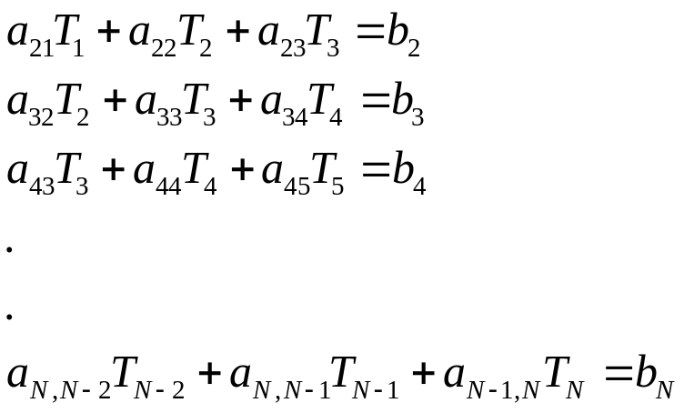
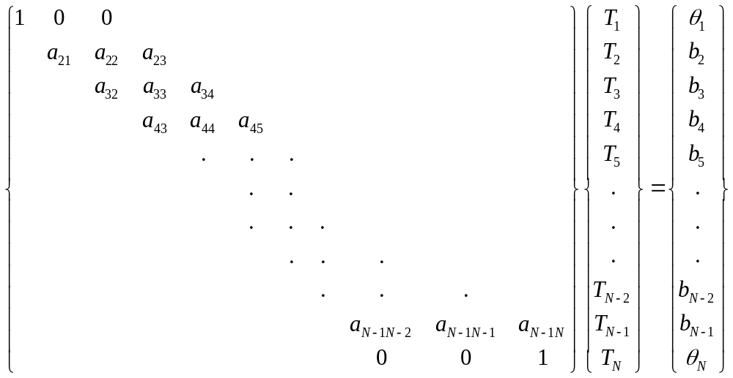

Fully implicit/ Steady conduction equation (1D)
1 2 3 4 5 6 7 N
Tridiagonal
System

Slide 3
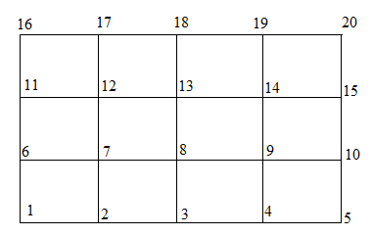

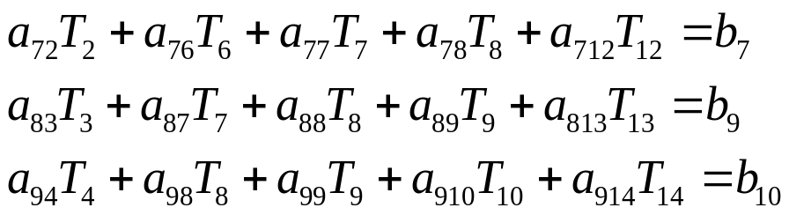
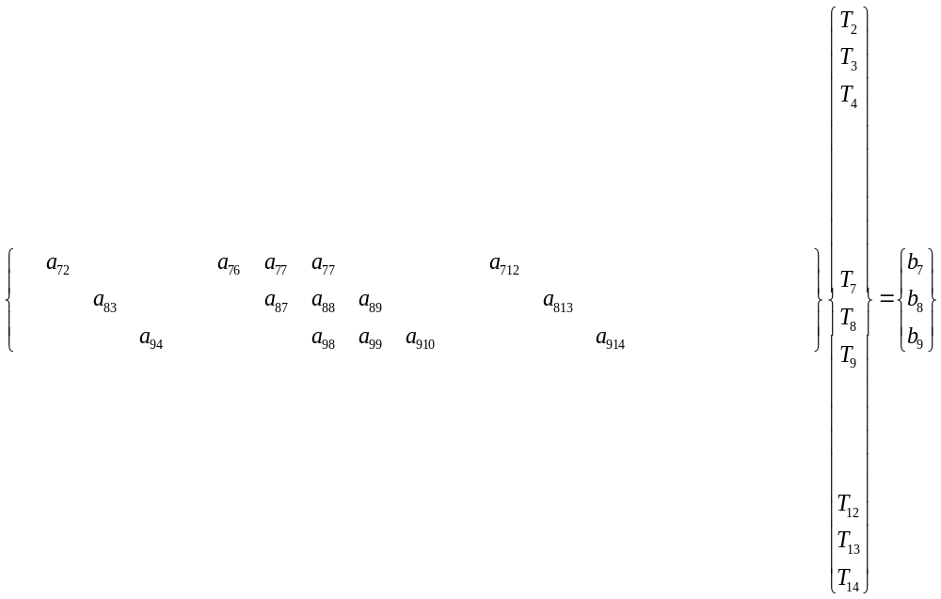
2D system
Pointers for solution vector
Pentadiagonal
System

Slide 4
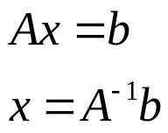
Solving Ax=b
Computational efficiency (minimum floating point operations)
Storage efficiency
Round off error
For unique solution the matrix must be invertible, i.e., rank(A)=order(A)
Essential boundary conditions
Direct inversion is costly in terms of computation and memory
Therefore, solution methodologies are adapted
Direct solution by Gauss elimination, LU decomposition, TDMA (tridiagonal matrix)
Iterative solutions: Gauss-Seidel Iteration [without and with over relaxation], Jacobi iteration
Line by line TDMA, ADI [combination of above two]

Slide 5



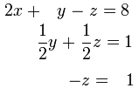

Direct Solvers: Gauss elimination
Operations: Results
i
Upper triangular form
ii
Back substituting
Disadvantage
Operational counts~O(n³) for nxn
Unsuitable for big matrix due to round off error
High storage

Slide 6
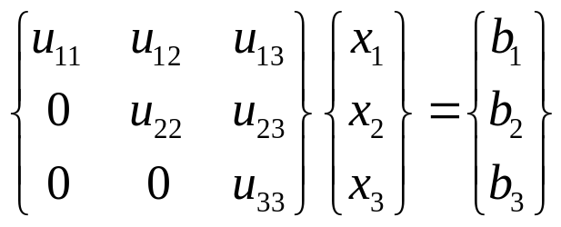
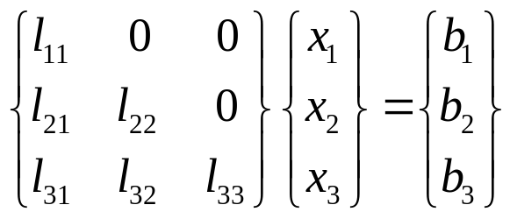
Direct Solvers: LU decomposition
Ax=b can be solved in a single set of substitutions if A is lower triangular
or
back substitution forward substitution
So LU decomposition of Ax=b follows
A=LU
LUx=b
Ly=b (and can be solved directly by forward substitution)
with Ux=y (this can be solved directly by back substitution)

Slide 7
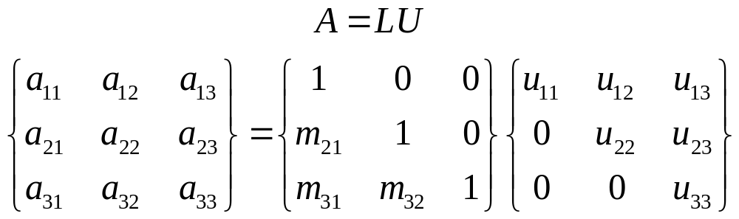
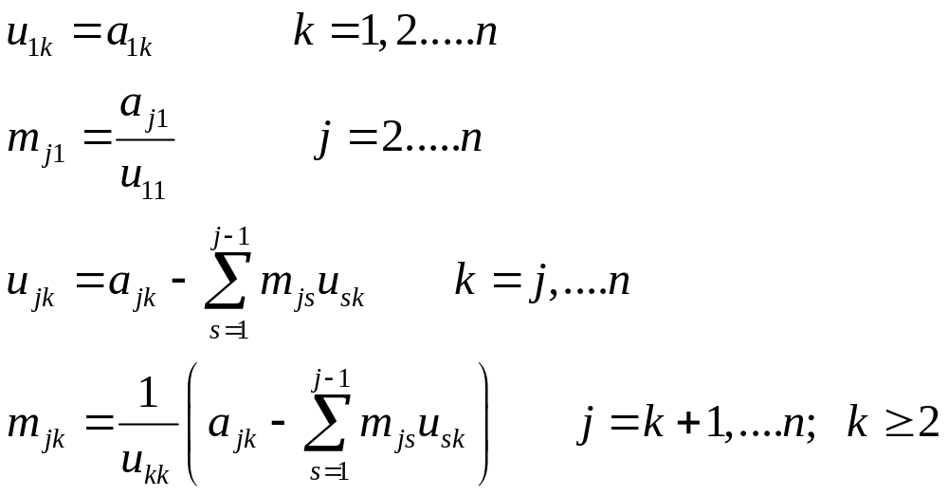
LU decomposition: Doolittle’s method
Formula for calculating m and u

Slide 8
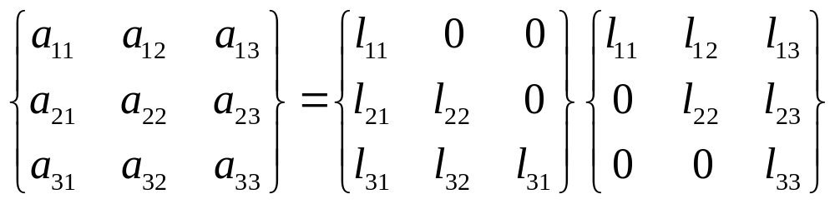
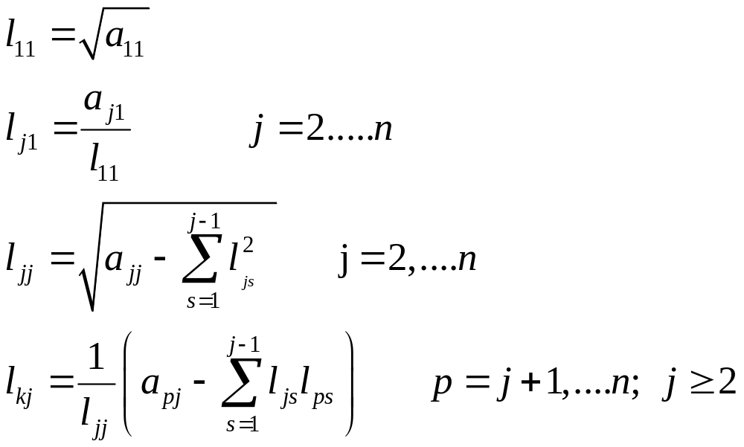
Cholesky’s method
For symmetric positive definite matrix (i.e. A=A^{T}, x^{T}Ax>0) we can use A=LL^{T}
Formula for calculating l

Slide 9

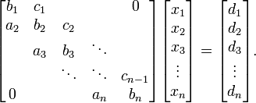
Sparse matrix is populated primarily with zeros.
Arises from partial differential equations. Most of the CFD matrices are sparse.
Storage is less for many zero-s, an efficient mapping of non-zero values are needed.
Diagonal dominance favors solvability
1D conduction equation gives tridiagonal matrix:
A tridiagonal system for n unknowns may be written as

Slide 10
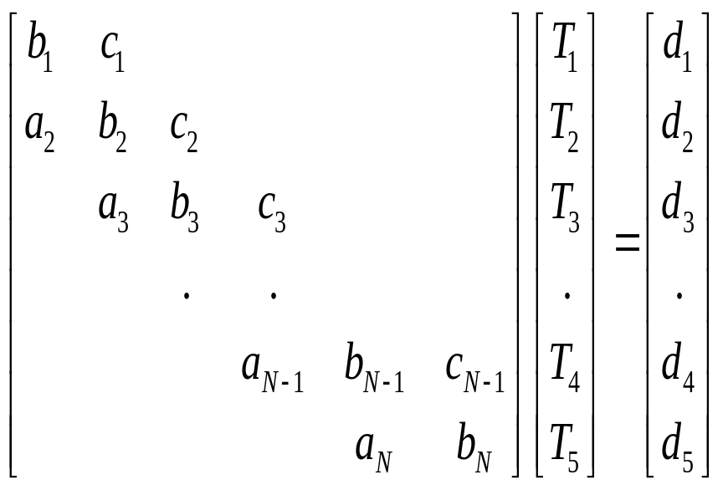
General form of tridiagonal matrix

Slide 11
Direct solution Schemes- Limitations
Cramer’s rule, Gauss elimination, LU decomposition or Gauss-Jordon method will seek O(N³) or more operations
For large physical domain, N may be very large for high accuracy
Large N indicates high computational time
Large N also introduces high round off error as number of steps are high and error accumulates in each step

Slide 12
Tridiagonal Matrix Algorithm (TDMA)
A Gauss elimination does not utilize the fact that this is a tridiagonal matrix, banded and sparse. Most elements in a row are zeros.
--- A specific algorithm for this type of matrices

Slide 13
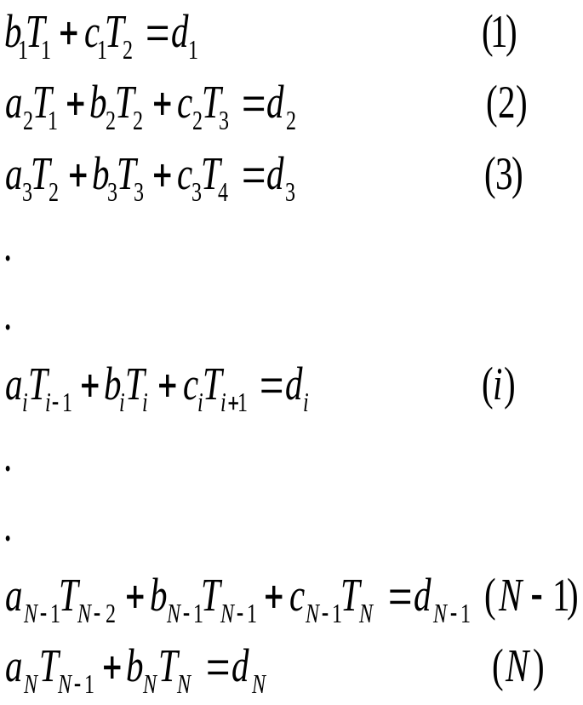
Thomas Algorithm or Tridiagonal Matrix Algorithm (TDMA)

Slide 14
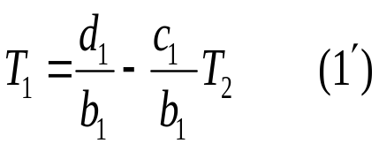
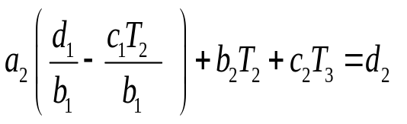
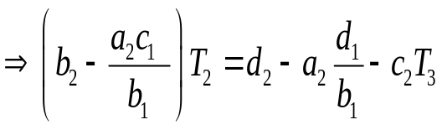
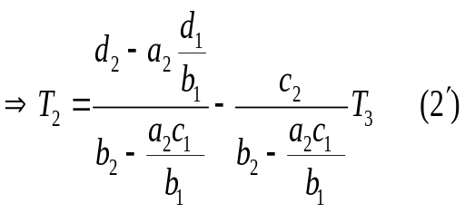
Getting a recursive relation
Eqn 1 gives
Substituting this in eqn 2
Similarly for eqn 3, 4… N-1, we can get expressions for T₂,T₄.. T_{N-1} respectively

Slide 15
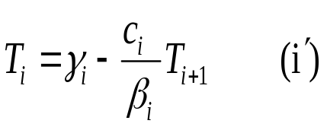
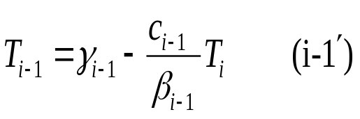

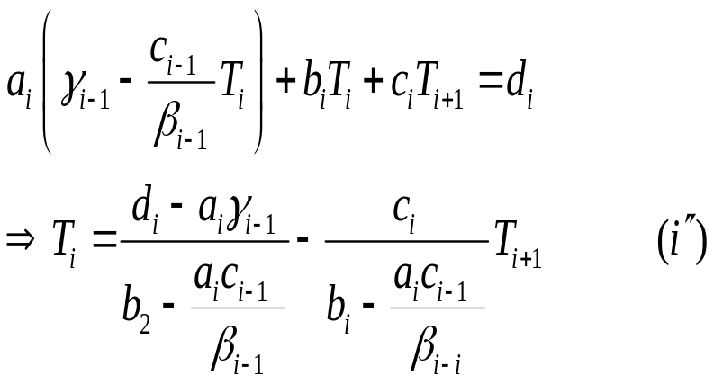
Eqn i will give
Similarly
Now, further substituting T_{i-1} in original eqn i
Now comparing (I’) and (I’’) a recursive relation is obtained

Slide 16
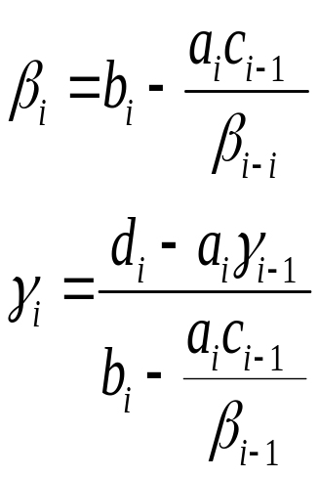
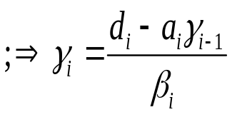
comparing (I’) and (I’’)
Recursive Relations!!
Till this point this method is like a Gauss Elimination step, where each pivot eliminates the next row’s first non-zero term. Does it only for the next row
The other terms below this row is already zero due to tridiagonal nature of matrix
So, operations are much less than Gauss elimination for a dense matrix. ~ O(N)
These steps go till N-1 the eqn, and a two equation –two unknown system is obtained by N-1 and Nth equations with T_{N} and T_{N-1}.

Slide 17
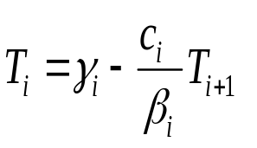
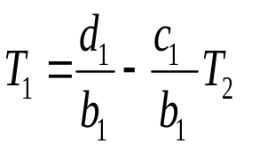
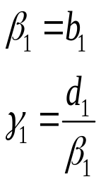

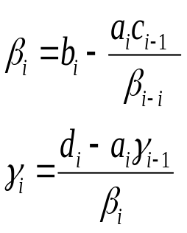
TDMA- Forward steps
So
Now
can be calculated using the recursive relations

Slide 18
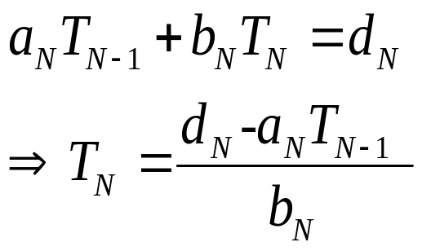
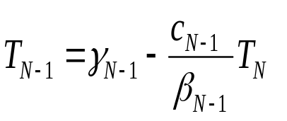
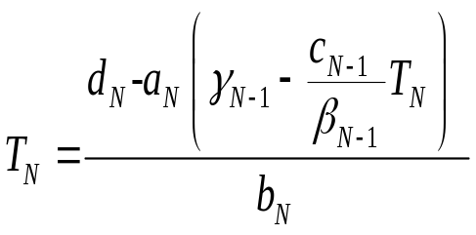
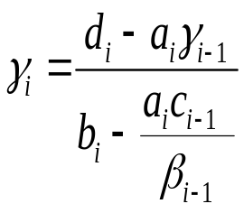
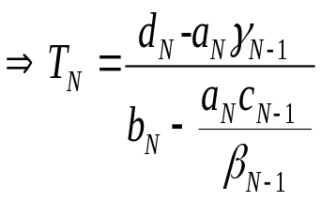

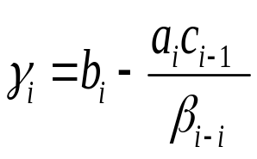
Backward steps
N-th eqn
Now,
Recursive relation for (N-1)th eqn
Substituting
as

Slide 19
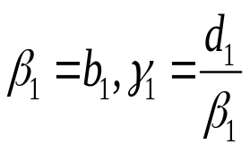
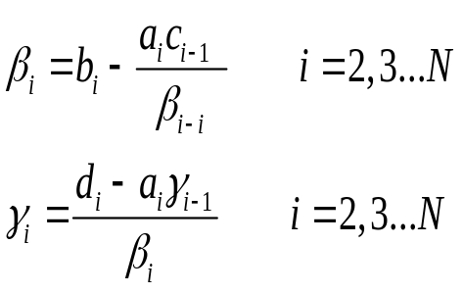
TDMA Algorithm
Consider matrix equation
1. Start with
2. Calculate

Slide 20

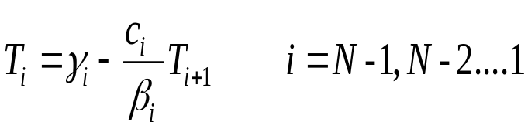
TDMA Algorithm (Contd)
3. Set
4. Obtain the other values
For a 5x5 matrix, TDMA takes 10 operations while Gauss elimination takes 75 operations!

Slide 21

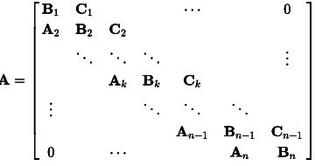
Variants
Sherman-Morrison formula for perturbed matrices
Block TDMA for block matrices

Slide 22

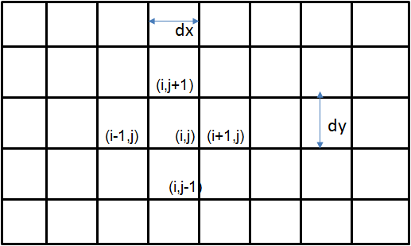

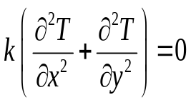
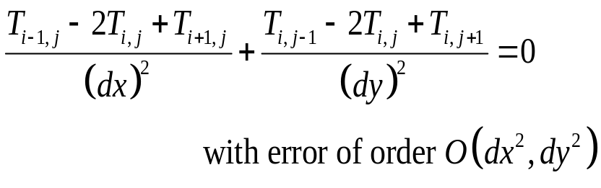
Alternating direction implicit method
Two dimensional problem:
y
x

Slide 23
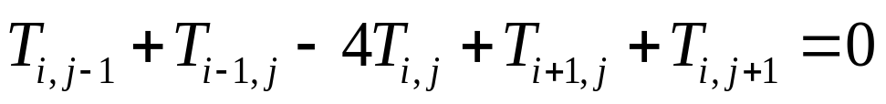
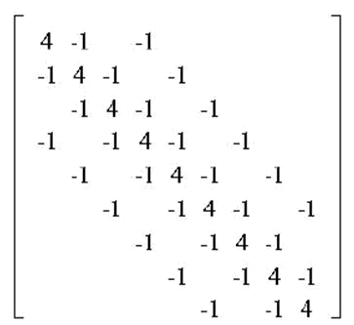
Two dimensional laplace equation –matrix representation
The matrix A looks like
Pentadiagonal matrix

Slide 24


Alternating direction implicit method
Assume a guess value
Solve for j=3 as
solve using TDMA
Assume a guess value
Put updated value
b* is guess value, solve using TDMA
Solve for j=2 as
Put boundary value
Sweep in y direction
Sweep in x direction
Continue the sweep till solution variables converge to a final value so that it does not change with any other sweep

Slide 25
Alternating direction implicit method
Iterative method
Solution started with a guess value converges to a final value which is close to the actual solution
Use TDMA at every step

Slide 26
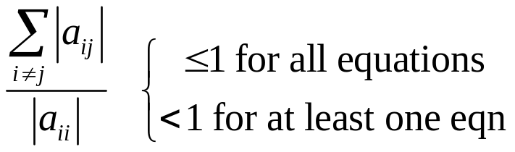
Implementation in c http://en.wikipedia.org/wiki/Tridiagonal_matrix_algorithm#Implementation_in_C
Iterative solvers
Basic iterative methods
Criterion: The Scarborough Criterion:
(diagonally dominant matrix)
Solution is assumed to be of a guess value x^{(k)}. Error due to this guess is calculated, based on which we update the guess solution unless a converged solution is not reached.
Round of error is not accumulated
Computationally cheap due to lower storage

Slide 27
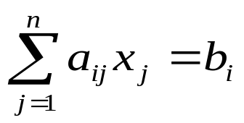
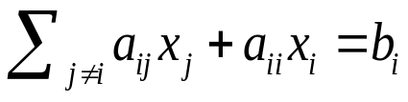
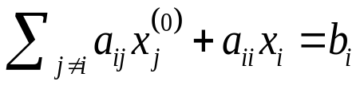
Iterative methods for matrix equations
Let us start with the matrix equation Ax=b
i-th row of the matrix represents the equation:
If we separate out the i-th component:
Now, let us assume a trial solution : x=x⁽⁰⁾
And further assume that in each equation, all other terms except the i-th term is evaluated using the trial solution as:

Slide 28

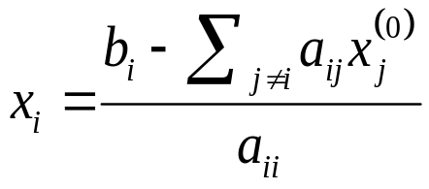
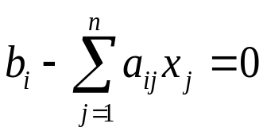
Basic iterative steps
From this, x_{i} can be evaluated as
provided a_{ii}≠0 :: Non-zero diagonals
(pivots?)
However, this x_{i} is not the actual solution as it is calculated using guess values.
We will not get

Slide 29



Basic iterative steps- Jacobi iteration
So we use an iterative method
The updated values of x_{i} are obtained after first iteration
Do this for all x-s, i=1…n
Use the updated x⁽¹⁾ as the new guess values and do the next iteration.
Probably we still end up in

Slide 30



Jacobi iteration
So, we need to update the guess values to be x⁽³⁾ and carry on the iterations….
We will still get:
Use the updated x, and carry on iterations for 3,4,5…. k-th times

Slide 31


How many steps?----Convergence
After large number of iterations, (k being sufficiently large)
At this stage the updates solution x^{(k)} converges the to solution x of Ax=b.
With further iteration we get:
ε is a very small number, its value depends on machine precision
Changes in the value of x is infinitesmall at next iterations -- CONVERGENCE

Slide 32


Jacobi iterations
Jacobi iteration is an iterative method for matrix solvers
Requirements for successful Jacobi method:
1. Non-zero diagonals, a_{ii}≠0

Slide 33




Iteration step in Jacobi method
Let us look into each rows during a Jacobi iteration step
However, the circled variables are already updated.
We can get faster convergence if the already updated values can be used.
-- Gauss-Seidel iterations

Slide 34



Gauss-Seidel Iterations
A Gauss-Seidel method step uses already updated values as:
Convergence criterion is same as Jacobi method

Slide 35




Jacobi Iterative methods in matrix form
Ax=b
-F
A=D-E-F
-E D
Jacobi step:
Written in matrix form

Slide 36




Gauss-Seidel Iterative methods in matrix form
Ax=b
-F
A=D-E-F
-E D
Gauss Seidel step:
Written in matrix form

Slide 37


General form of an iteration step
For Jacobi: M=D, N=-E-F
For Gauss-Seidel: M=D-E, N=-F
Rate of convergence depends on largest eigenvalue of matrix G

Slide 38



Diagonally dominant matrices
A matrix A is called
Weakly diagonally dominant if
Strictly diagonally dominant if
Irreducibly diagonally dominant if
Irreducibly / strictly diagonally dominant matrices show non-zero pivots (at least in a permuted form)and hence non-singular

Slide 39




Theorem for convergence of iterations
If A is a strictly diagonally dominant or an irreducibly dominant matrix, then the associated Jacobi or Gauss Seidel iterations converge for any x₀.
Can be solved using these methods
Not even
The row-permuted form
Can not be

Slide 40


Numerical experiments
Consider matrix generated as finite difference approximation of
A tridiagonal matrix is obtained.
Matrix size is varied by varying number of grid points
An example 8x8 matrix

Slide 41
Numerical experiments
Matrix size |  | Spectral radius of G, ρ(G) | Convergence rate, η=-ln(ρ(G)) | Number of iterations for convergence till ε=10⁻⁶
10x10 | Jacobi | 0.94632 | 0.05517 | 200
 | Gauss-Seidel | 0.89533 | 0.11034 | 106
20x20 | Jacobi | 0.98645 | 0.01364 | 709
 | Gauss-Seidel | 0.97309 | 0.02728 | 374
40x40 | Jacobi | 0.99661 | 0.00340 | 2435
 | Gauss-Seidel | 0.99322 | 0.00680 | 1291

Slide 42


How to improve convergence?
Jacobi/ Gauss-Seidel iteration step:
This is the difference that x covers in a particular iteration till it converges to the exact solution x*
If x^{(k+1)}-x^{(k)} can be increased at each iteration step, number of iterations will be reduced!
Successive over relaxation is proposed

Slide 43

Successive Over Relaxation (SOR)
Optimum OR factor found by numerical experimentation
(~1.8)
Formulation:
http://en.wikipedia.org/wiki/Successive_over-relaxation#Formulation
Non-linear equations may need under-relaxation, w<1
Relaxation for unsteady formulations

Slide 44
Successive over-relaxation (SOR)- Convergence
Theorem:
If A is symmetric with positive diagonal element and for 0<ω<2, SOR converges for any x₀, iff A is positive definite.
If ω>2, SOR will diverge
If ω=1, SOR is same as the basic G-S or Jacobi method.
If ω<1, SOR is actually under-relaxing the iterations or increasing the number of iterations.
Optimum value of ω?

Slide 45

Numerical experiments- Gauss Siedel and SOR
Obs: No. of iterations are least at a particular SOR factor – Optimum over relaxation parameter

Slide 46
Computer Programming for Iterative methods

Slide 47

Jacobi Iteration -- Algorithm
Matrix equation: Ax=b
A is diagonally dominant
i-th row of the matrix represents the equation:
Now, let us assume a guess solution : x=x⁽⁰⁾
For k=0,1,2…. Update x as
Till convergence:

Slide 48
Operational steps
Sum for large number of j – for each of the i rows
For k=0,1,2…. Update x as
For large values of k
Till convergence:
So, a large number of steps are followed for large matrices

Slide 49
Computer programming for Jacobi method
Sum of all the terms in each row – Looping the sum over all rows to update each elements of vector x
Looping this update for large k times till convergence
Need to store old values of x to compute updated x and compare with updated x.

Slide 50

Jacobi C Code excerpt

Slide 51

Gauss-Seidel
Matrix equation: Ax=b
A is diagonally dominant
i-th row of the matrix represents the equation:
Now, let us assume a guess solution : x=x⁽⁰⁾
For k=0,1,2…. Update x as
Till convergence:

Slide 52
Computer programming for Gauss-Seidel method
Sum of all the terms in each row – Looping the sum over all rows to update each elements of vector x
Looping this update for large k times till convergence
New x will be computed using most updated available values of x
Old values of x are used only for checking convergence

Slide 53

Successive Over Relaxation
Matrix equation: Ax=b
A is diagonally dominant
i-th row of the matrix represents the equation:
Now, let us assume a guess solution : x=x⁽⁰⁾
For k=0,1,2…. Update x as
Till convergence:

